Slide 1

Final Project: Group 3
Team Members:
Jay Patel
Sharad Swaminathan
Aishwarya Babu
Ianesh Karthik Bandhuchoday
GitHub: https://github.com/sharadsw/itcs6160-project

Slide 2

INTRODUCTION
CampusEats is a food delivery app build by team Maverick, we have extended the project by adding a rating system. The Objective of this project is to get the rating of all the restaurants and delivery drivers according to their performance.
We have added the following tables:
rating
menu
menu_order
The rating table has the following columns, rating_id (PK), food_rating, delivery_rating, comments, picture_link, and order_id (FK).
The menu table has the following columns, item_id (PK), item_name, item_desc, restaurant_id (FK).
The menu_order table is an associative table which has the following columns, menu_order_id(PK), item_id, order_id and cooking_specification .

Slide 3
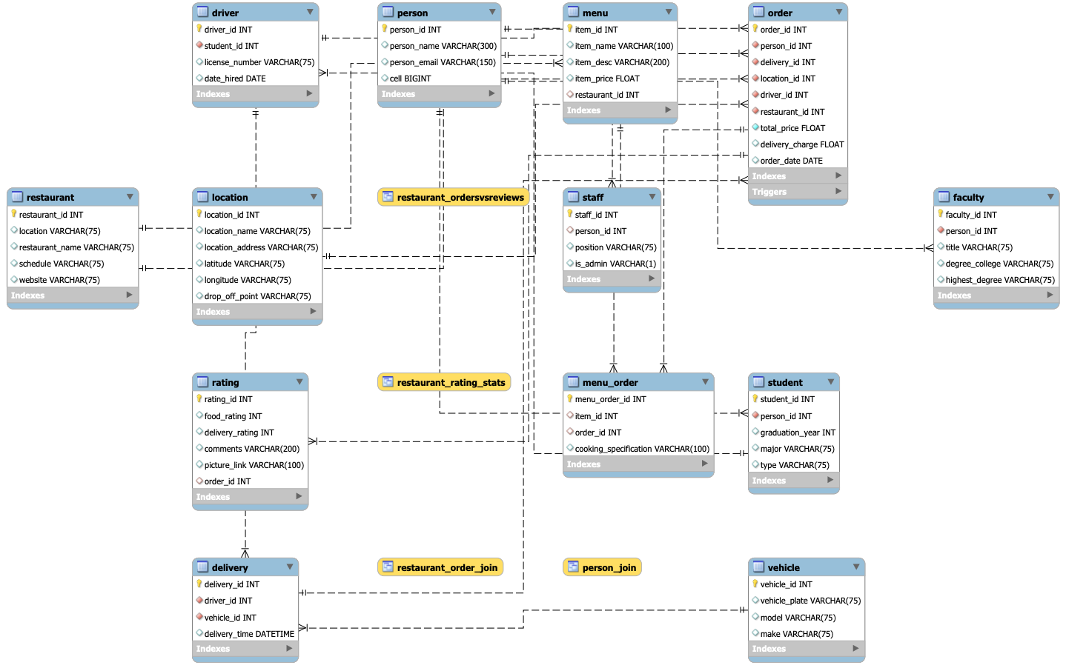
EERD

Slide 4
OPERATIONS
The 3 advanced sql statements include: functions, stored procedures, indexes and views. We have also added indexes to two columns.
Functions:
get_restaurant_id
get_person_id
get_item_id
Views:
delivery_driver_ratings
restaurant_rating_stats
restaurant_ordersVSreviews
Stored procedures:
add_restaurant
add_vehicle
customer_restaurant_rating
total_order_cost
total_order_count
Indexes:
menu_index
restaurant_index

Slide 5
DEMO!

Slide 7


Slide 8


Slide 9


Slide 10


Slide 11


Slide 12


Slide 13


Slide 14


Slide 15


Slide 16


